Slide 1




NFH (original); 31, 4
NFHD2; 40, 4
D2: delete 36-72
Rerun alg on D2
NFH (phos); 36, 4
NFHD2 (phos); 33, 4
Note: not currently doing this

Slide 2
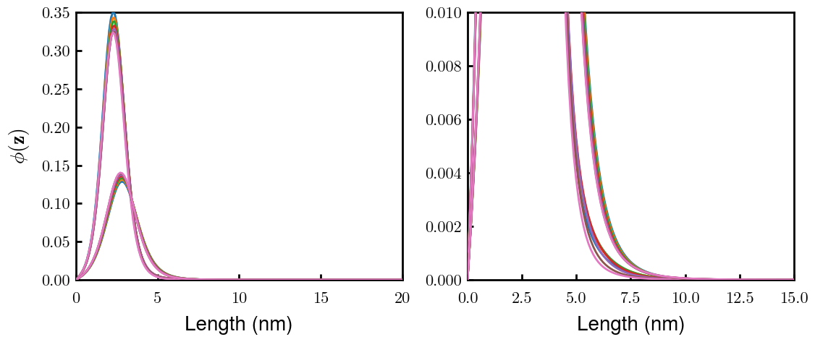
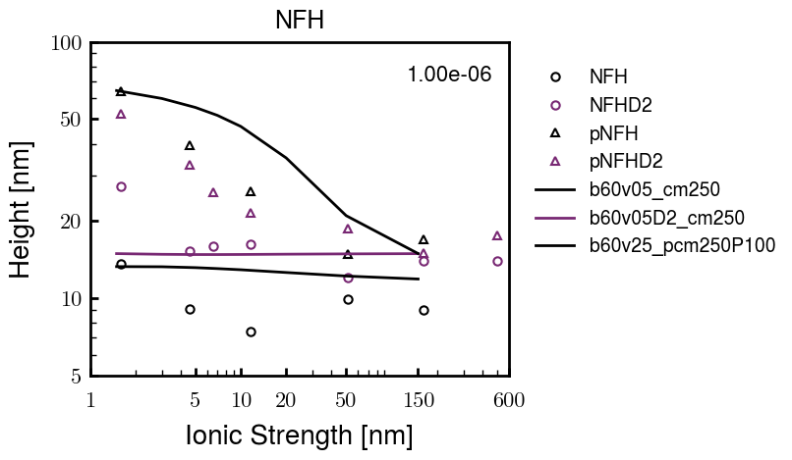
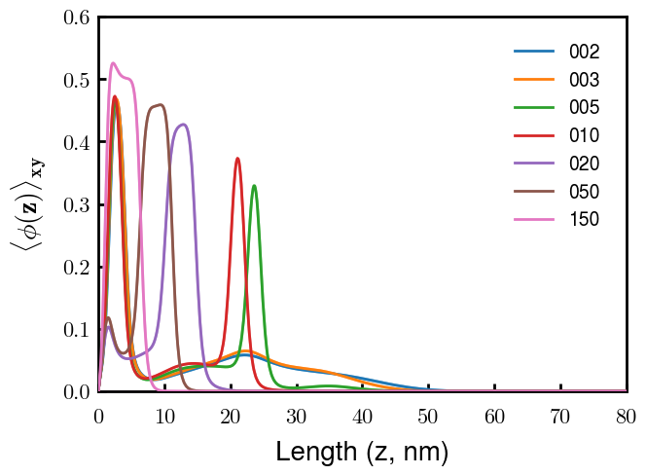
Best fit
NFH
NFHD2
pNFH
(v = -1)
Points
v05 → v25 after phosphorylation
Bilayer (trilayer for 5?) pNFH morphology

Slide 3
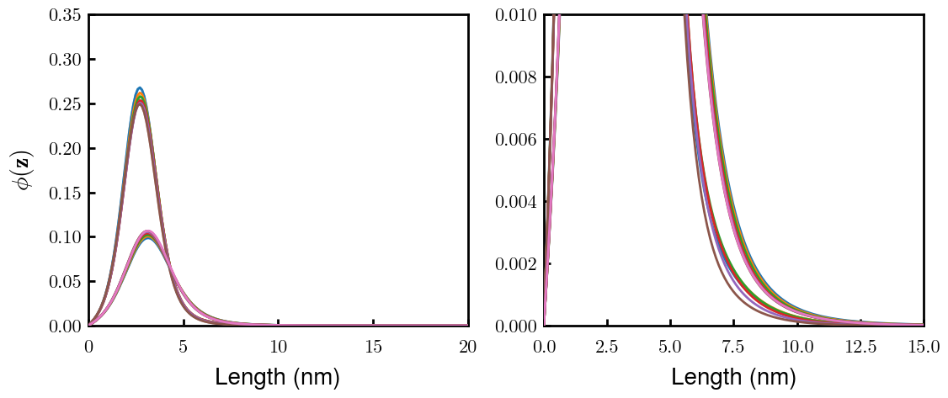
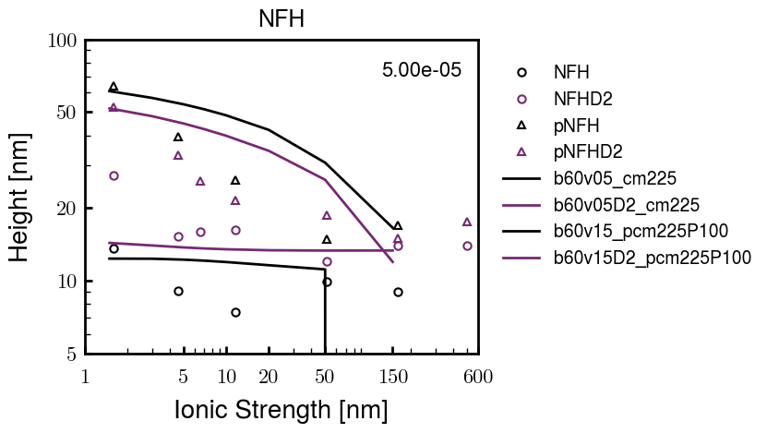
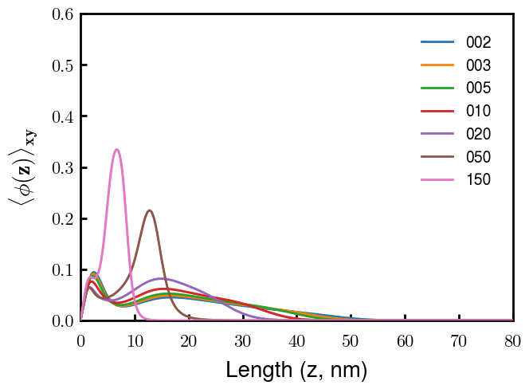
Best fit without multilayer
NFH
NFHD2
pNFH
(v = -1)
Points
v05 → v15 after phosphorylation
No condensed multilayer but worse fit

Slide 4






Native NFH

Slide 5







NFHD2

Slide 6




pNFH(D2)
4e-03

Slide 7








1e-06
4e-03
norm
4e-03
Try to bring pNFH down → {cmXX + PXX} only choice
norm
4e-03
3e-04
3e-04
3e-04

Slide 8





Heights.params : b60v05 cm200
norm
1e-06
1e-05
1e-04
4e-03

Slide 9






Heights.params : b60v05 cm250
norm
ylog
norm
ylin
1e-06
1e-05
1e-04
5e-03

Slide 10




Heights.params: b60v10 cm{200, 225}
norm
1e-06
1e-05
1e-04
5e-03

Slide 11



Slide 12



 | Slope Bins 4 | Smear Count 25
Block number | Alpha w/ Henderson Hasselbalch | Chi Chi_max = 2.2
[0 50] | 0.040012 | 1.160000
[50 75] | -0.278451 | 0.720000
[75 125] | -0.519707 | 0.608000
[125 156] | -0.154453 | 0.529032

Slide 13


 | Slope Bins 4 | Smear Count 31
Block number | Alpha w/ Henderson Hasselbalch | Chi Chi_max = 2.2
[0 31] | 0.001103 | 0.922581
[31 62] | -0.386873 | 0.703226
[62 93] | -0.290146 | 0.967742
[93 496] | 0.037164 | 1.098759
[496 527] | -0.064533 | 0.819355
[527 620] | 0.010682 | 0.756989
[620 647] | -0.103326 | 0.696296

Slide 14






Previous
New

Slide 15





Slide 16


Response to stimuli given composition
Same data
Effect of composition given environment

Slide 17


NFL, pH 7.44, phos 1.5e (locs from LCMS)
Non-phos NFL
Block number | Alpha w/ Henderson Hasselbalch | Chi Chi_max = 3.2
[0 50] | 0.040012 | 1.540000
[50 75] | -0.278451 | 0.960000
[75 125] | -0.519707 | 0.868000
[125 156] | -0.154453 | 0.690323
 | Slope Bins 4 | Smear Count 25
Block number | Alpha w/ Henderson Hasselbalch | Chi Chi_max = 3.2
[0 50] | -0.019988 | 1.540000
[50 75] | -0.278451 | 0.960000
[75 125] | -0.519707 | 0.868000
[125 156] | -0.154453 | 0.690323

Slide 18


NFM, pH 7.44, phos 1.5e (locs from LCMS)
 | Slope Bins 4 | Smear Count 32
Block number | Alpha w/ Henderson Hasselbalch | Chi Chi_max = 3.0
[0 32] | 0.079143 | 1.275000
[32 64] | -0.186340 | 1.125000
[64 96] | -0.327964 | 1.181250
[96 160] | -0.460694 | 0.787500
[160 224] | -0.124999 | 1.115625
[224 288] | -0.023510 | 0.956250
[288 352] | -0.242085 | 1.003125
[352 384] | -0.031302 | 1.125000
[384 416] | -0.123860 | 1.050000
[416 438] | 0.046945 | 1.281818

Slide 19





Bin 3 NFM, pH 7.44, phos 1.5e (locs from LCMS)

Slide 20




Bin 5 NFM, pH 7.44, phos 1.5e (locs from LCMS)

Slide 21



Phos 2 NFM, pH 7.44, phos 2.0e (locs from LCMS)

Slide 22



Chi 2.5 NFM, pH 7.44, phos 2.0e (locs from LCMS)

Slide 23



NFM, pH 7.44, non-phos

Slide 24


NFH, pH 7.44, phos 1.5e (locs from LCMS)
 | Slope Bins 4 | Smear Count 36
Block number | Alpha w/ Henderson Hasselbalch | Chi Chi_max = 3.2 | Chi Chi_max = 3.0
[0 36] | 0.000945 | 1.266667 | 1.20000
[36 72] | -0.527455 | 0.900000 | 0.85000
[72 324] | -0.208376 | 1.729365 | 1.628571
[324 396] | -0.111195 | 1.416667 | 1.333333
[396 432] | -0.152824 | 1.344444 | 1.266667
[432 647] | -0.033955 | 1.077209 | 1.015814

Slide 25




Phos block dashed
Phos block dashed

Slide 26



Best are b3.0 v2.0 and b3.0 v3.0, but max H not high enough
Possible solutions:
Lower chi_max
Change aa_disc to have more charge
Force spectra?
Better for low salt, but high salt will melt brushes together

Slide 27



M1
pMx5

Slide 28



b3.00; v1, 2
b4.00; v2, 2.5, 3, 5, 10
b5.00; v3, 10, 15, 40
53 Nk
39 Nk
32 Nk

Slide 29
Binary results

Slide 30



Matrix Approach
Updated 04/04/2023

Slide 31














H Vol decrease (by v)
H Vol decrease (by b)
Desired “linearity” by tuning /thresh/ based on polymer density of expelled NFL
L Vol decrease (by b)
Comes at severe cost of overall height. Have to minimize outer concentration to approach pure thresh of 1e-06

Slide 32














H Vol decrease (by v)
H Vol decrease (by b)
Chimax 3.5
Desired “linearity” by tuning /thresh/ based on polymer density of expelled NFL
L Vol decrease (by b)
Comes at severe cost of overall height. Have to minimize outer concentration to approach pure thresh of 1e-06

Slide 33








F (3.5)
Chimax 3.5
Chimax 3.0
Scaled by 1.5
Scaled by 1.6
Scaled by 1.6
Scaled by 1.5
Scaled by 1.5
Scaled by 1.5
Scaled by 1.8
Scaled by 1.8

Slide 34
















Last test: same stiffness factor (b^3/v0) but with varying total volume

Slide 35












H Vol decrease (by v)
H Vol decrease (by b)
a2C_30
a2D_30
a2E_30
Rerun for Cs
b1C_30
b1D_30
b1E_30
L Vol decrease (by b)
a1C_30
a1D_30
a1E_30
g1C_30
g1D_30
g1E_30
Rerun for Cs

Slide 36












H Vol decrease (by v)
H Vol decrease (by b)
a2C
a2D
a2E
b1C
b1D
b1E
Block 4 (NFL end)
L Vol decrease (by b)
a1C
a1D
a1E
g1C
g1D
g1E

Slide 37









H Vol decrease (by v)
Chimax 3.5
H Vol decrease (by b)
a2C_30
a2D_30
a2E_30
b1C_30
b1D_30
b1E_30
L Vol decrease (by b)
a1C_30
a1D_30
a1E_30
g1C_30
g1D_30
g1E_30

Slide 38







For i as L and H:
Pure height profiles
Mixed height profiles
Current L library
Current H library
Skip; marginal increase in vol prob not enough
Move onto chi3.0; larger NFL vol library

Slide 39





NFL
All plotting wrong L pure; look only at purp
NFH
H volume too low to neutralize L (v = 31 nm3/c)

Slide 40







H volume v = 60 nm3/c

Slide 41







H volume too low to neutralize L

Slide 42










NFH, V = 70
L30

Slide 43





NFH & NFL v = 0.15
a2D
b1D
g1D

Slide 44





Based on NFH b5v15c3, apply VL = VH
NFL and NFH are from same amino acids but diff chain lengths. Should VL = VH?
L30 / H70
L80 / H20
L30 / H70
L80 / H20

Slide 45






L30 / H70
L80 / H20
L30 / H70
L80 / H20

Slide 46
L Fitting

Slide 47


VL = VH

Slide 48







Try b change, v same as H (0.15)
Phi unrealistic (?)
Phi unrealistic
Phi very unrealistic
Phi very unrealistic

Slide 49






Try similar params to H
5.6
11.2
16.8
28
56
7.5
11.25
18.75

Slide 50







Try similar params to H, b0.36
7.8
15.6
23.4
31.2
Unrealistic vol
Not very sensitive to v; not high enough to intersect neighboring chains (function of b and sigma)

Slide 51


Continuation from prev params

Slide 52







v2.7 and some fine
b1.50 v2.7 c3.2
b1.75 v2.7 c3.2
b1.75 v2.5 c3.2
b1.75 v2.5 c3.0
b2.0 v2.7 c3.2
b2.25 v2.7 c3.2
b2.50 v2.7 c3.2
Phi too small to decrease v0

Slide 53










b2.0 v10.0 c3.0
b2.0 v8.0 c3.0
b2.0 v6.0 c3.0
b2.0 v4.0 c3.0
b2.0 v2.0 c3.0
Phi limit
b1.8 v10.0 c3.0
b1.8 v8.0 c3.0
b1.8 v6.0 c3.0
b1.8 v3.0 c3.0
b1.8 v2.0 c3.0
Phi limit

Slide 54





b1.6 v10.0 c3.0
b1.6 v8.0 c3.0
b1.6 v6.0 c3.0
b1.6 v2.0 c3.0
b1.6 v1.5 c3.0
Phi limit

Slide 55









b2.0 v2.7 c3.2
b3.0 v3.5 c3.5
b3.0 v7.0 c3.5
b3.0 v7.0 c3.0
Phi too small
Phi too small to decrease v0
b4.0 v12.0 c3.0
b5.0 v20.0 c3.0
b5.0 v20.0 c4.0
b5.0 v5.0 c3.0
b5.0 v10.0 c3.0
Phi too small to decrease v0

Slide 56





v20
b5.0 v20.0 c3.0
b4.5 v20.0 c3.0
b4.0 v20.0 c3.0
b3.5 v20.0 c3.0
v10
b5.0 v10.0 c3.0
b4.0 v10.0 c3.0
b3.0 v10.0 c3.0
b2.0 v10.0 c3.0

Slide 57




b2.00 v2.70 c3.20
b2.00 v2.75 c3.20

Slide 58
NFH fitting (from NFL best fit)

Slide 59








b1.00, v0.50, c3.2
b2.00, v4.00, c3.2, th2.5e-02
b1.00, v2.00, c3.2
b1.00, v1.00, c3.2

Slide 60
Mixture

Slide 61



Slide 62


b = 0.75

Slide 63





Slide 64
b = 1.0

Slide 65





Slide 66
b = 1.25

Slide 67




Chi 2.6
Bad vol frac

Slide 68








b25v0
b25v1
b25v2
b25v3

Slide 69




Chi 2.8
Bad vol frac

Slide 70





Slide 71
b = 1.50

Slide 72






Chi 2.8
Bad vol frac

Slide 73





Slide 74

b = 2.00
v4 = 0.25*b^3

Slide 75


Bad vol frac

Slide 76



Slide 77
Fine tune

Slide 78



b1.25, v1.95, c3.0
b1.50, v3.38, c3.0
b2.00, v4.00, c3.0
Norm seems to capture kinked behavior

Slide 79




Slide 80



b1.25, v1.95, c3.2
b1.50, v3.38, c3.2
b2.00, v4.00, c3.2

Slide 81




Slide 82


b1.25
b1.50
b2.00
c2.8
c3.0
c3.2

